Slide 1
SWIS: See What I Saw
Hasit Mistry
Project Advisor: Dr. David Socha

Slide 2
Introduction
“A picture is worth a thousand words”; a video has got to be more than that.
There is a rise in the videography industry – GoPro, Sony, TomTom.
People in fields like life logging, amateur filming and video storytelling are using high-quality compact cameras for continuous capture.
Consumer grade 360° video cameras are becoming increasingly useful for collecting immersive video datasets.

Slide 3
Traditional vs. 360° Camera Systems
A traditional video camera system has a FOV than ranges between a few degrees to, at most, 180°. In other terms, light is captured, at most, in a hemisphere.
A 360° video camera system has a FOV of ~360°.
A focal length of 50mm, assumed to match the perception of the human eye, has a FOV of ~40°.
Compared to traditional camera systems, videos generated by 360° camera systems capture a much larger view.

Slide 4
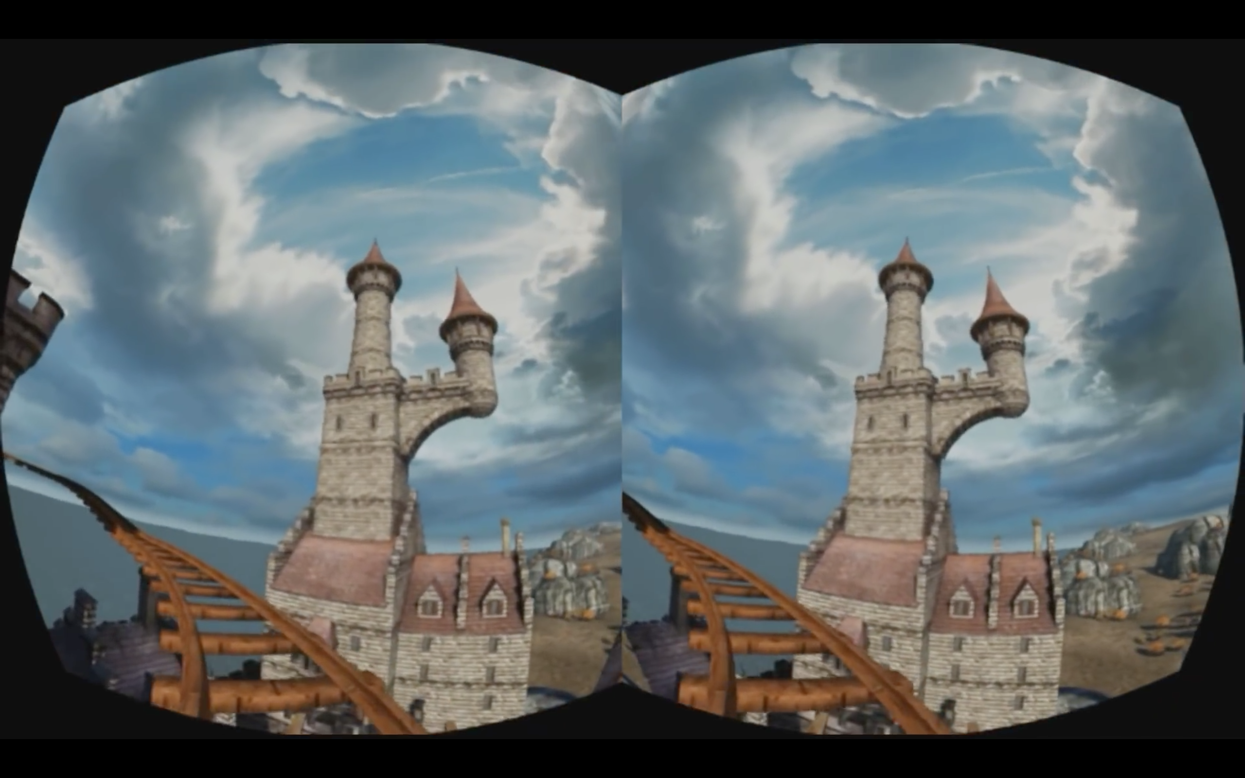
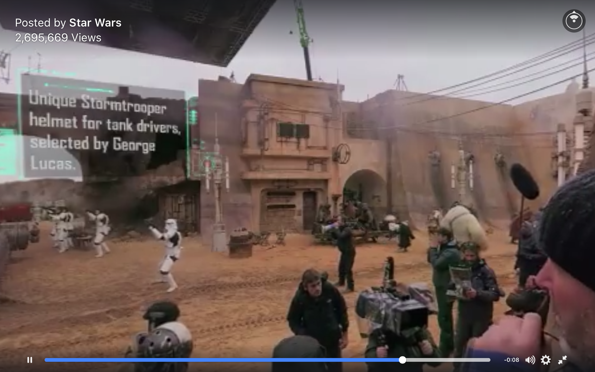
Viewing 360° Videos
Display technologies have evolved – more personal and immersive.
Oculus Rift, HTC Vive and Sony Morpheus headsets are popular for watching 360° videos, playing VR games and other VR applications.
360° videos can be viewed on
VR headsets by splitting each frame into right eye and left eye views (stereoscopic view) using built in gyroscope.
Flat screen monitors using special video players and input devices like mouse or keyboard.

Slide 5
Motivation
The motivation behind SWIS is to allow people who work in collaboration with videos (specifically 360° videos) to share their ‘viewpaths’.
SWIS allows users to share what they saw, exactly how they saw it.

Slide 6
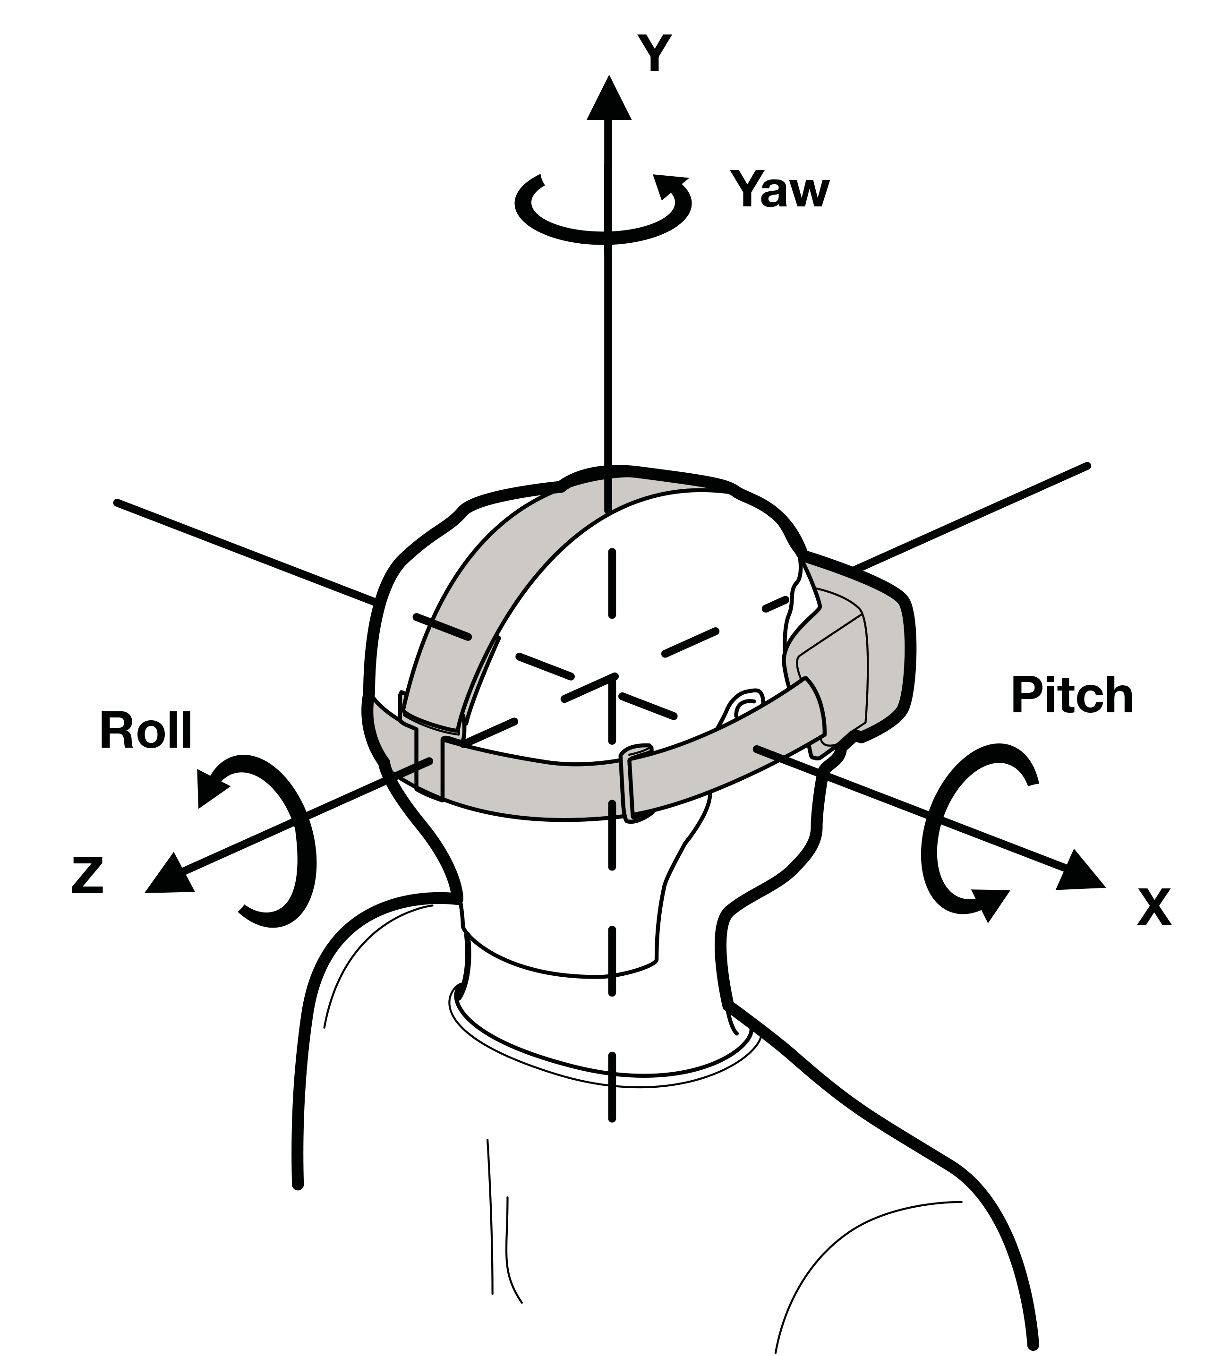
360° video has a temporal as well as a spatial dimension.
Describing a scene in a 360° video is more difficult than a traditional video.
Imagine that you want to describe a hand movement in a 360° video 12 minutes at the precise angles x = 50°, y = 35° and z = 4°.
Wouldn’t it save time to just look at what you want your colleague to see and share an intermediate file instead?
SWIS intends to simplify this workflow by generating an intermediate ‘viewpath’ file that holds the information of what the user saw along with its video offset information.

Slide 7
Scenarios
Collaboration between researchers who rely on video datasets.
Sharing computer and console game replays.
Sharing shorter clips of 360° videos from internet video platforms.
Security surveillance using video datasets.

Slide 8
Problem Definition

Slide 9
Mathematical Model

Slide 10
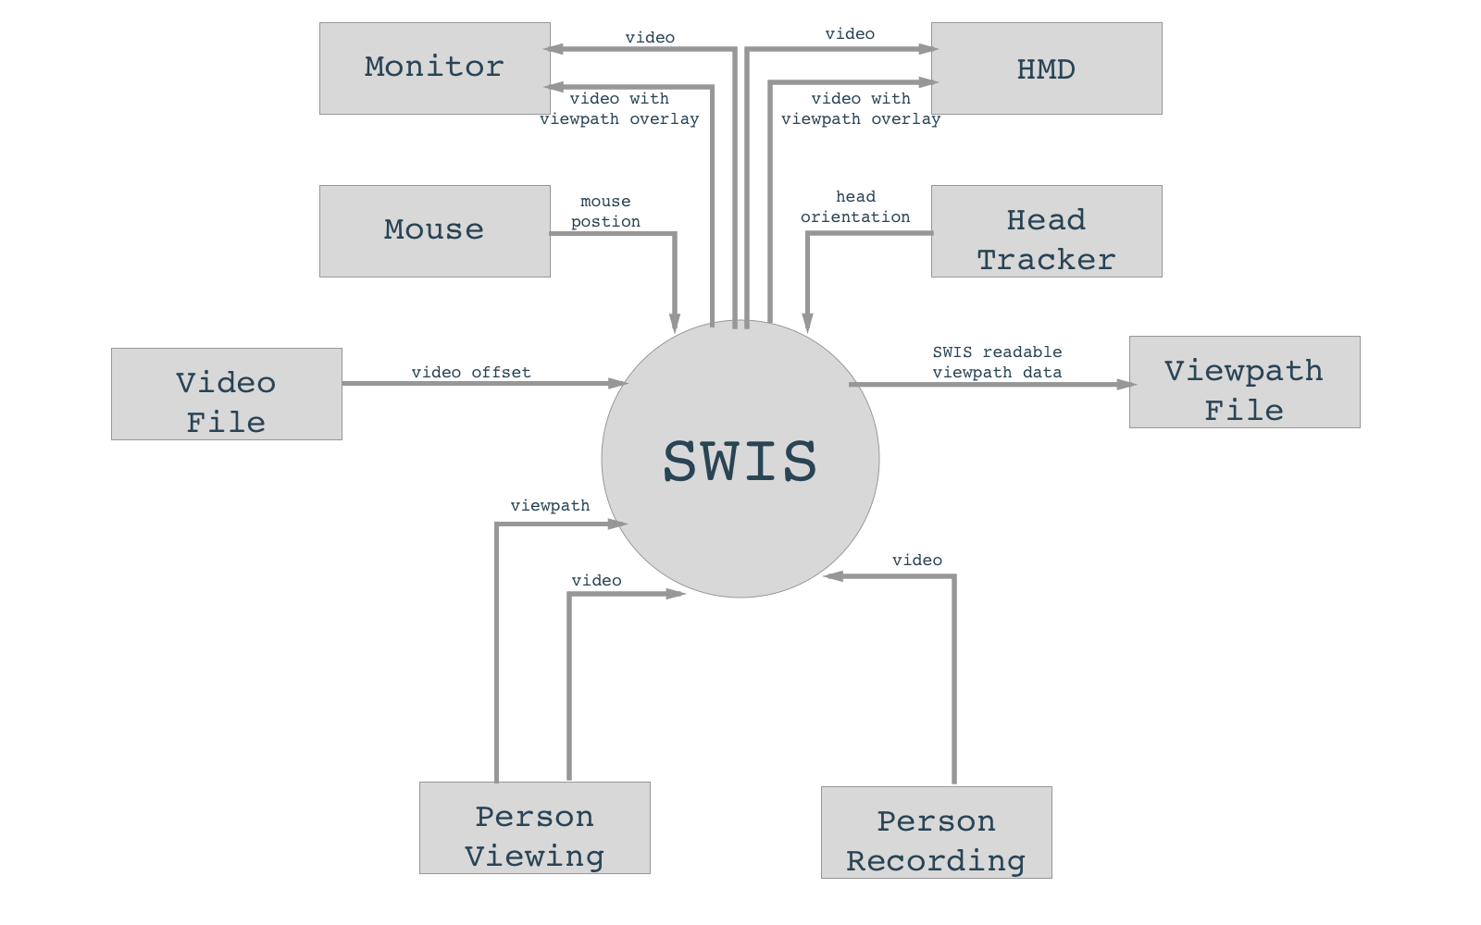
System Architecture

Slide 11
Software Methodology

Slide 12
Project Demo

Slide 13
Conclusion

Slide 14
Future Work

